Slide 1

Artificial Intelligence
with Python
COMP 3122
Reza Dibaj

Slide 2

Quick Review of Whole IT in One Slide
Operating Systems
System S/W
Utilities
Software
Languages
Super High Level
Applications
High Level
Computer
Middle Level
Low Level
Hardware

Slide 3

Skimming our Reference Book

Slide 4
Important Notes on Python
Online Jupyter:
https://jupyter.org/try
Quick Python Recap:
https://learnxinyminutes.com/docs/python3/
On of the best quickest recap videos which was mentioned in the python official web site:
https://www.youtube.com/watch?v=_uQrJ0TkZlc
One of the best series of videos on pandas:
https://www.dataschool.io/easier-data-analysis-with-pandas/

Slide 5

Python Refresher(Optional Activity)
Sign up on https://checkio.org/
Solve a few problems from Elementary or Home bases…
It is cool, eh?

Slide 6
Python Refresher(Optional Activity)
Instructions
Use the Python cheetsheet→ http://learnxinyminutes.com/docs/python3/
Sign up at https://checkio.org/, then start from "Elementary" problems.
Create a directory for your work.
Copy & paste the code from CheckIO to a text editor (VSCode) and save it as a .py file.
Open "Anaconda Prompt", CD to your directory and run “ipython”.
Use %run yourfile.py to run and test the code.
Once all assertions pass, copy the code back to the text box on checkio.org and click on Check.

Slide 7


How to get pandas….
The best way is to install Anaconda Distribution
Which contains all pandas dependencies….
https://www.anaconda.com/distribution/
You can follow the steps in the

Slide 8


Let’s Start Some Coding….
Let’s start writing a few lines together…. Ready?
Please open 01-Python - Hello world.pptx and start reading the slides.
These amazing slides are provided by my Excellent Team Member, Sathish!

Slide 9

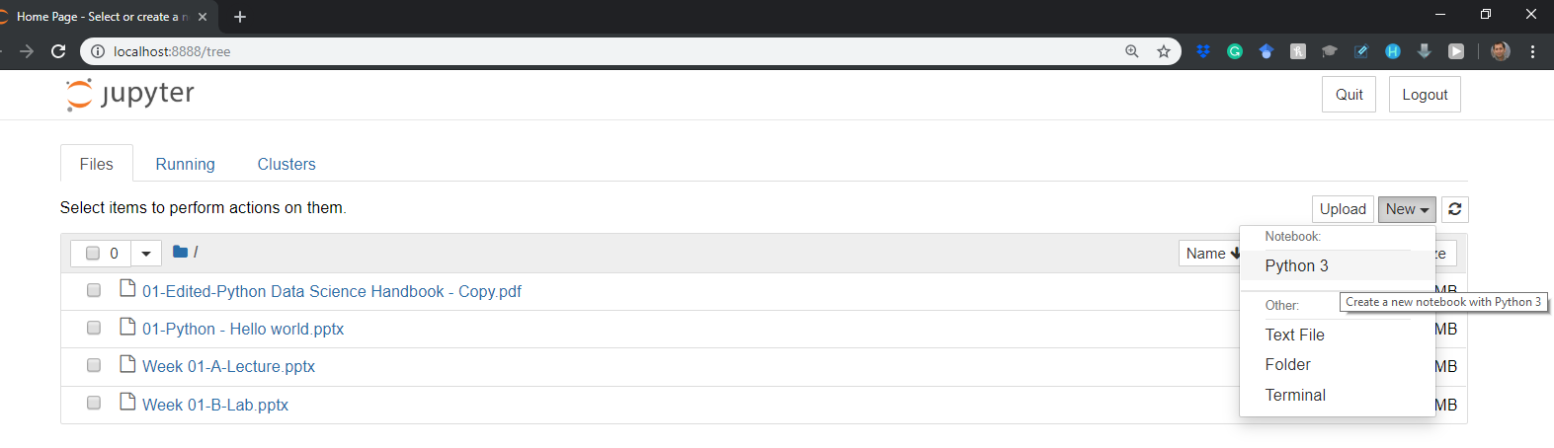
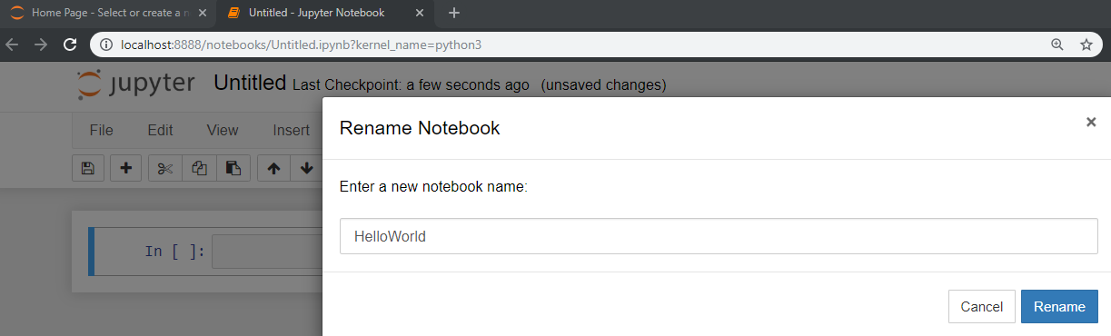
Let’s Start Some Coding….
How about a bit more Python for now?
1
2
3
4

Slide 10
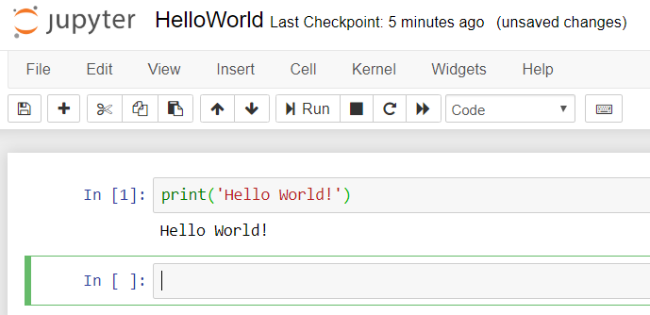
Hello World sort of thing….
Please, type the following command and press Shift + Enter to run!
Notes:
print('Hello World!')

Slide 11
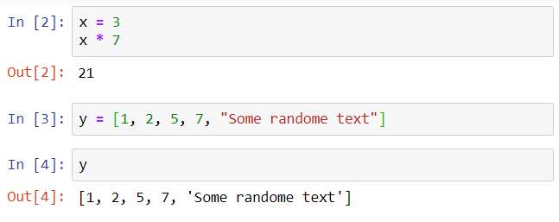
Hello World sort of thing….
We are almost there… Let’s try the following commands as well :)
Notes:
x = 3
x * 7
y = [1, 2, 5, 7, "Some randome text"]
Y

Slide 12

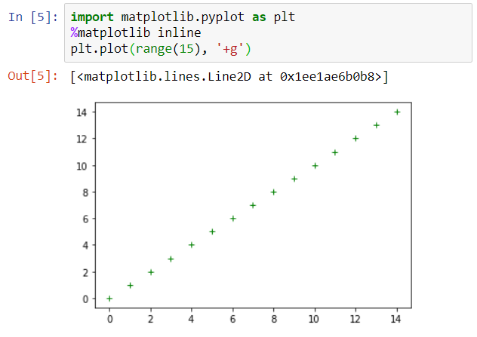
Hello World sort of thing….
Finally…. YESSSSS! We did it!
Notes:
import matplotlib.pyplot as plt
%matplotlib inline
plt.plot(range(15), '+g’)

Slide 13

PS….
If you have hello.py in your current Jupyter Notebook path, you can type and get the following result.
Hello.py is a python file provided before and you just run it as follows:
Notes:
%run ./hello.py

Slide 14

Thank you
Question?
To be
Not to be

Slide 15

Appendix:
Installation Process of
Anaconda Distribution of Python on Windows

Slide 16
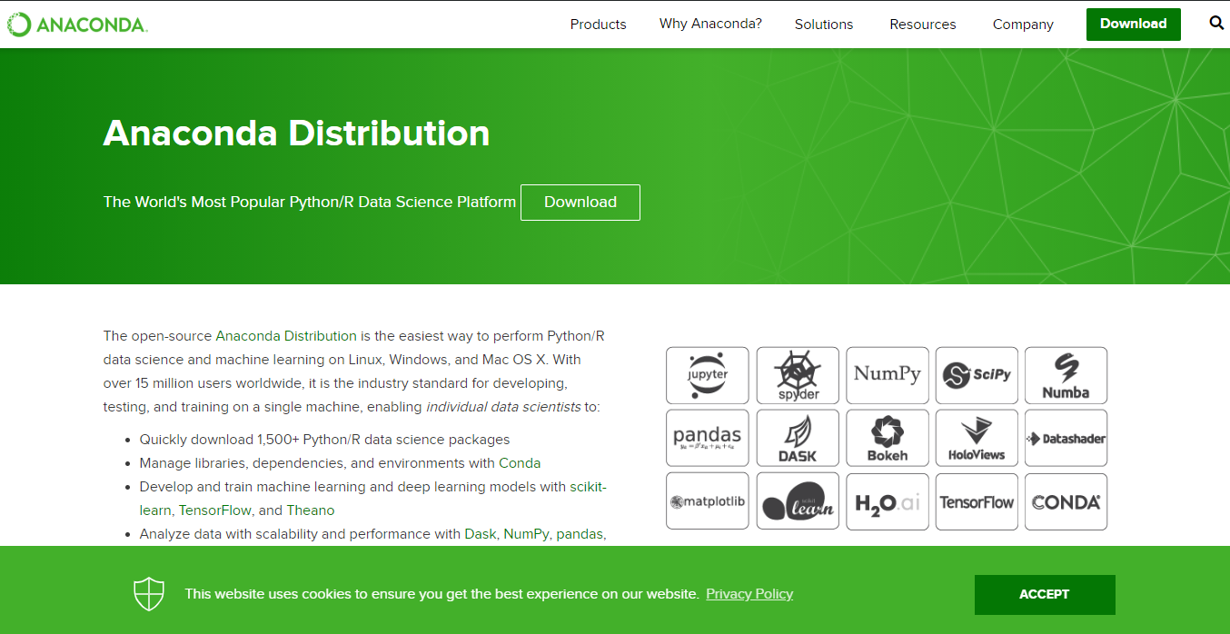
Anaconda Distribution of Python
Notes:
https://www.anaconda.com/distribution/

Slide 17
Anaconda Distribution of Python
2
1

Slide 18
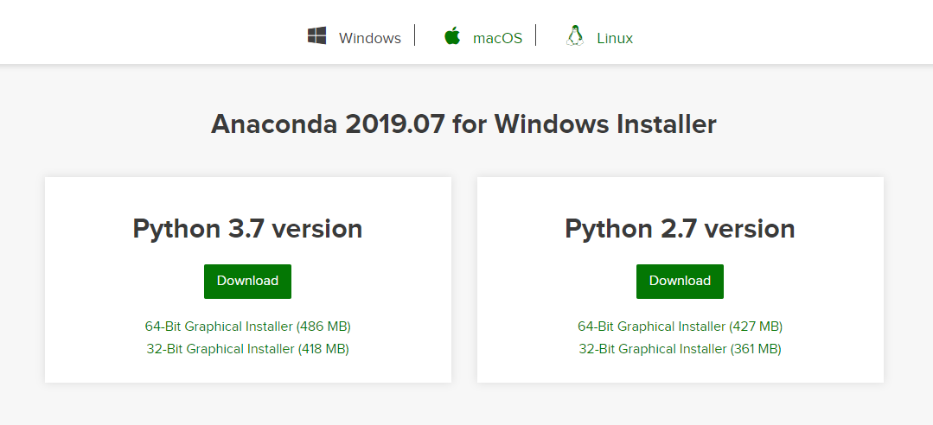
Anaconda Distribution of Python
1
2

Slide 19
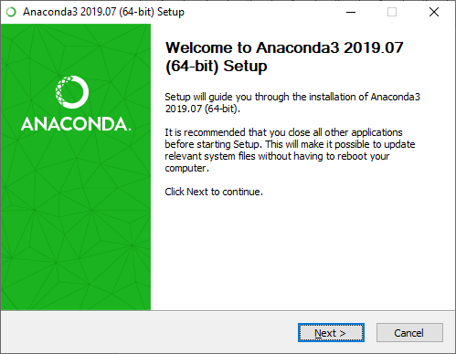
Installation Process
1
2

Slide 20
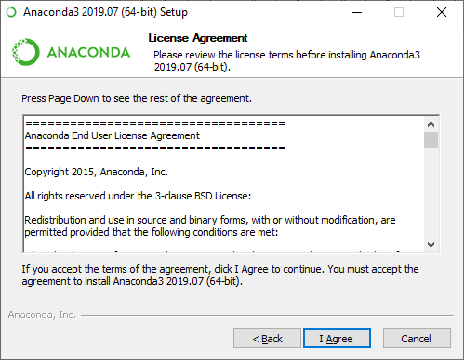
Installation Process

Slide 21
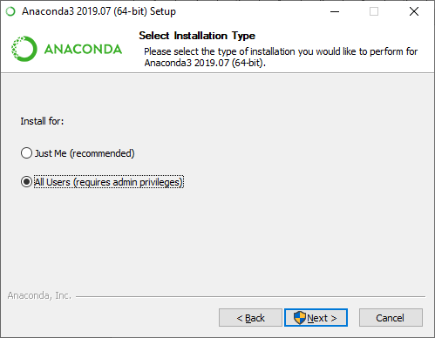
Installation Process
1
2

Slide 22
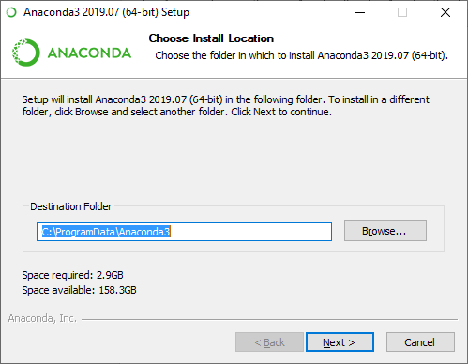
Installation Process
You can change the installation path or leave it as it is.
1
2

Slide 23
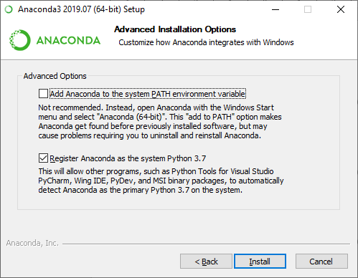
Installation Process

Slide 24
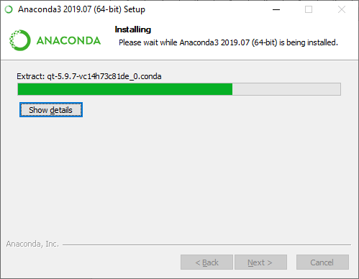
Installation Process

Slide 25
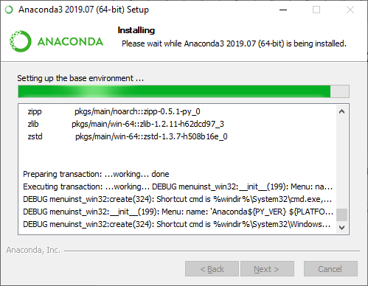
Installation Process

Slide 26
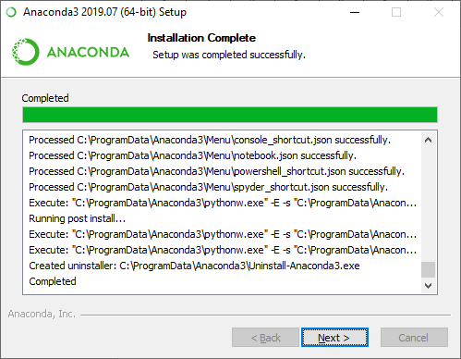
Installation Process

Slide 27
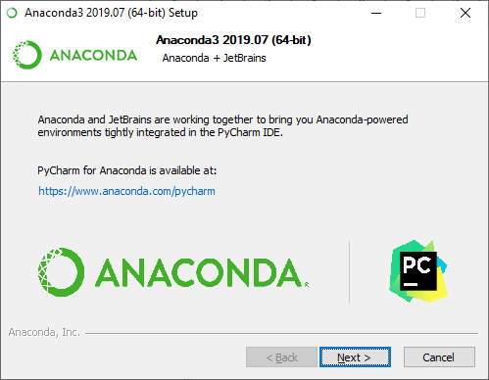
Installation Process

Slide 28
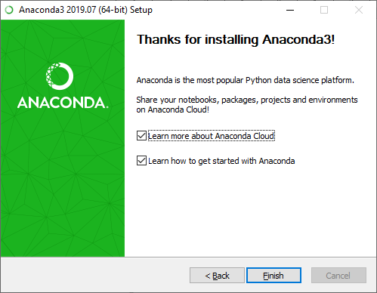
Installation Process

Slide 29
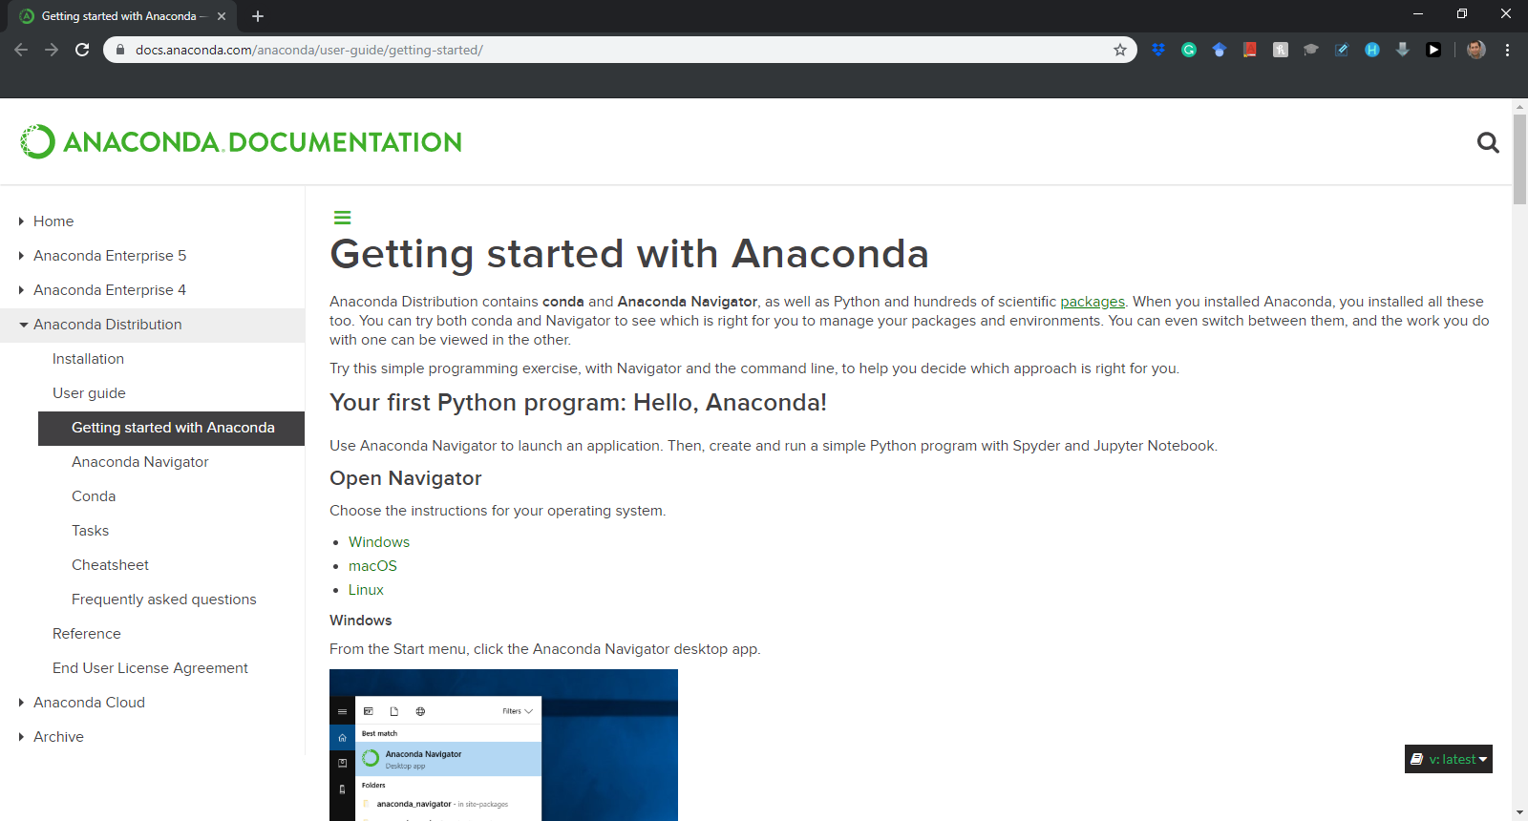
Installation Process
Notes:
https://docs.anaconda.com/anaconda/user-guide/getting-started/

Slide 30
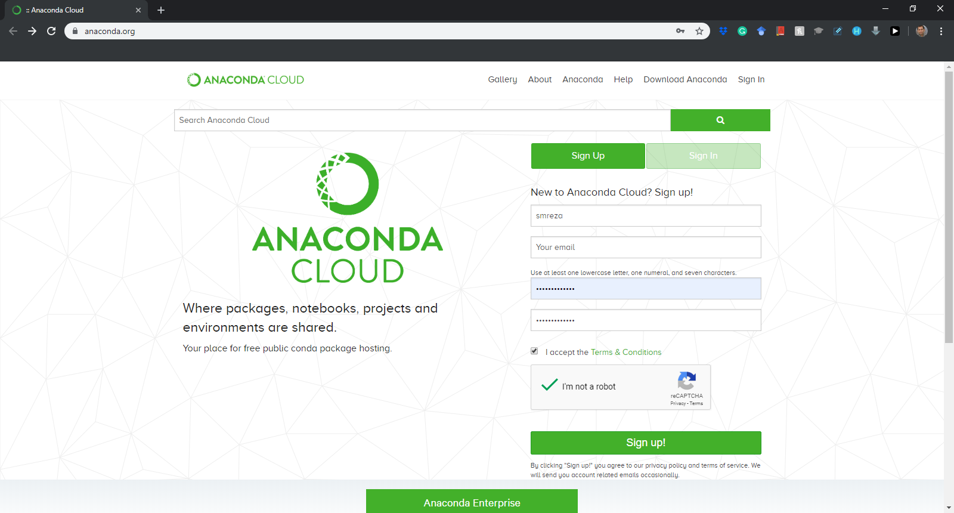
Installation Process
Sign up for the first time….
Notes:
https://anaconda.org/

Slide 31
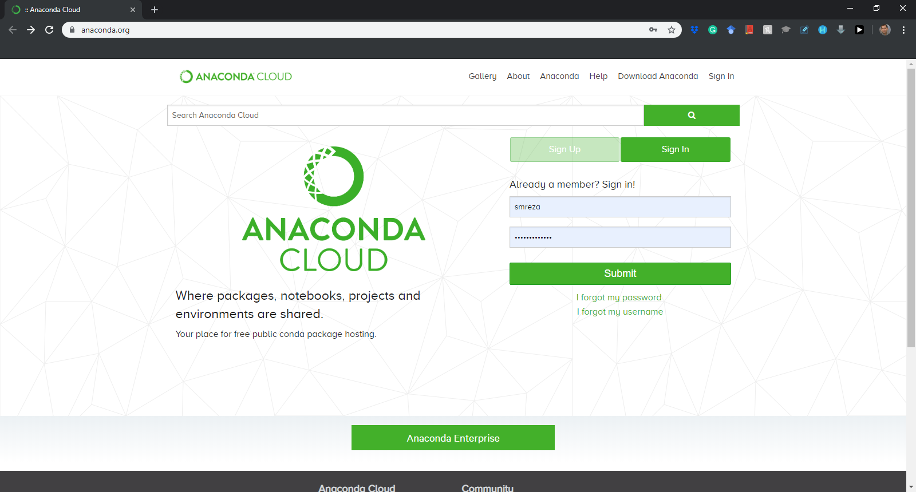
Installation Process
Sign in after the first time….
Notes:
https://anaconda.org/

Slide 32
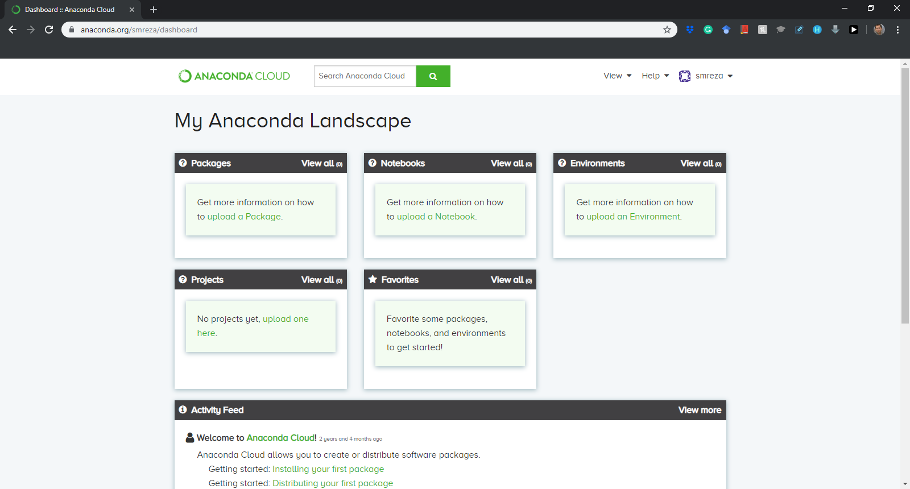
Installation Process

